Slide 1

Cyber security threats 2015-2024
By Eri (Elizabeth) Howard
August 2025

Slide 2
About the dataset
This dataset sourced from Kaggle here: https://www.kaggle.com/datasets/atharvasoundankar/global-cybersecurity-threats-2015-2024
Covers cybersecurity incidents in 10 countries from 2015 to 2024.
The countries mentioned are Australia, Brazil, China, France, Germany, India, Japan, Russia, the UK, and the USA.
There were initially 3000 rows, and 10 columns. No duplicate, missing or outlier variables.
Variables include: Country, Year, Attack Type, Target Industry, Financial Loss, Number of Affected Users, Attack Source, Security Vulnerability Type, Defense Mechanism Used, & Incident Resolution Time.

Slide 3
More on Attack Types
DDoS - Distributed Denial of Service - Basically overwhelm the servers of a website, or network with too many requests at once. Often a network of 'zombie' computers with a type of malware installed on them will be involved, unknown to the users of these devices. The same result can also happen accidently, like with people knowing a sale will be on a certain website at a certain time, and too many users overloading the servers by all wanting something at once.
Phishing - Scam websites or emails that seek to gain sensitive information by pretending to be others.
SQL Injection - Specific to data driven applications. These insert a malicious line of code that carries out an action such as sending all that information to the hacker. It can also be used to alter or destroy all the data in the system. - We should be very aware of these sorts of attacks!
Ransomware - Malicious software that makes a user's data or system inoperable or encrypted as to be inaccessible until an amount is paid to the attackers.
Malware - Malicious software, computer viruses of various types. intentionally designed to cause harm or disruption to systems, clients, networks or servers or to leak sensitive information etc.
Man-in-the-Middle - Attacker receives information by being 'in between' two sources. For example, someone's emails are being routed through an unknown 3rd party, or unsecured websites without knowledge of the other parties.

Slide 4
On security vulnerabilities
Zero-day - A hole or exploit in the software that the developers and those who could stop it are unaware of.
Social Engineering - Psychological influence (though not direct manipulation) of persons within the targeted organization.
Unpatched Software - Software where a zero-day or other vulnerability was fixed, but that has not been updated.
Weak Passwords

Slide 5
On Defense mechanisms
Antivirus - Software that scans for 'viruses' or software that is flagged as potentially harmful in some way to the computer or network.
VPN - Stands for Virtual Private Network - This encrypts the user's internet connection and disguises the user's identity online.
Encryption - This means that the data has been made into a cypher that needs to be decrypted or translated to be understood.
Firewall - a security system that protects the network, not the individual computer.AI-based Detection - Like an anti-virus but more advanced detection capabilities.

Slide 6
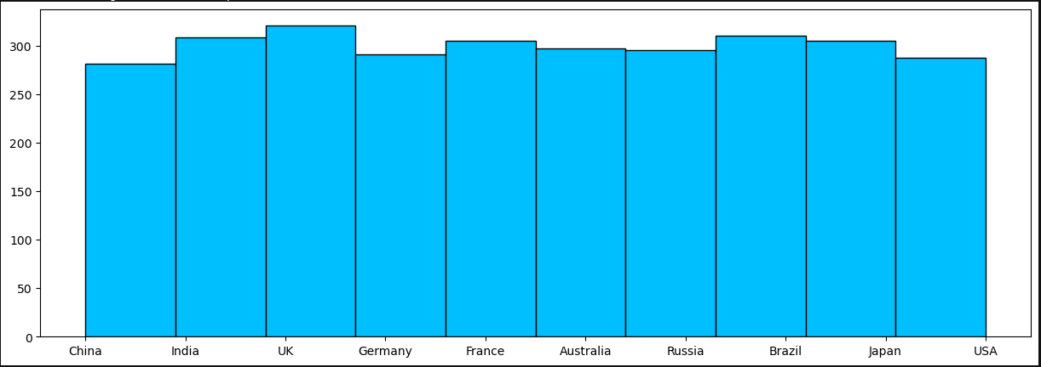
Univariate Analysis –Countries involved

Slide 7
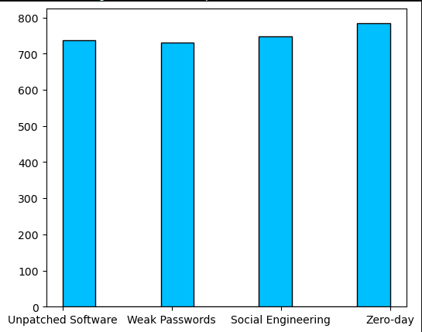
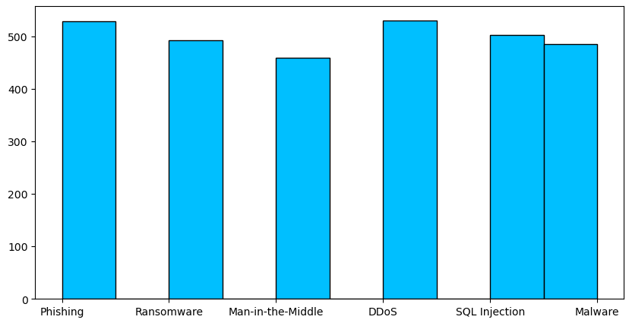
Attack Types and Vulnerabilities

Slide 8
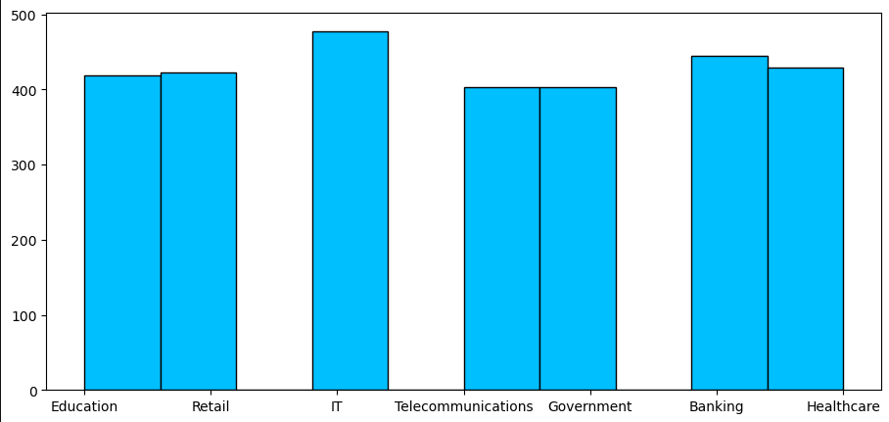
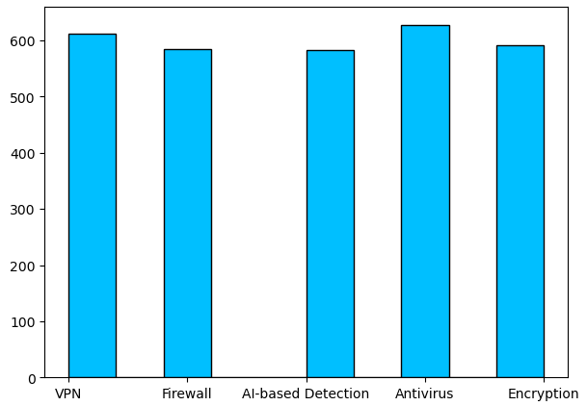
Industries and Defense Mechanisms

Slide 9
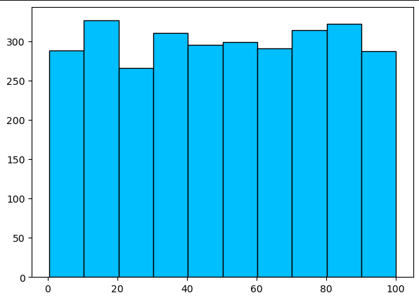
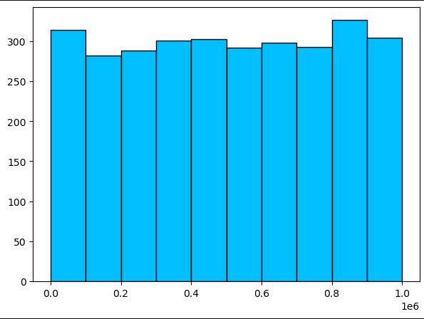
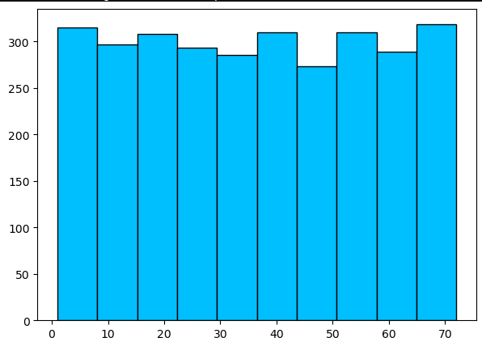
Financial Loss in Millions
Number of Users Impacted
Resolution Time in Hours

Slide 10
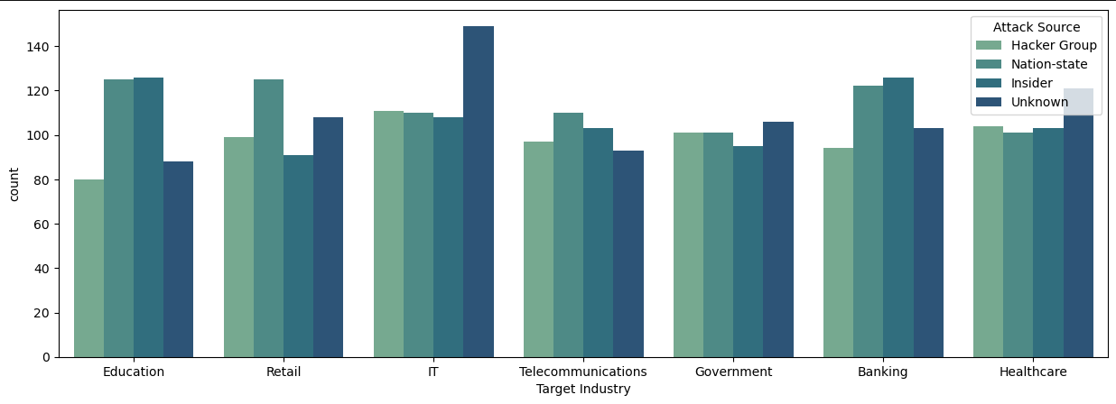
Bivariate Analysis
Attack Source vs Target Industry is the only place where there was any statistically significant correlation between any categorical variables at all.

Slide 11
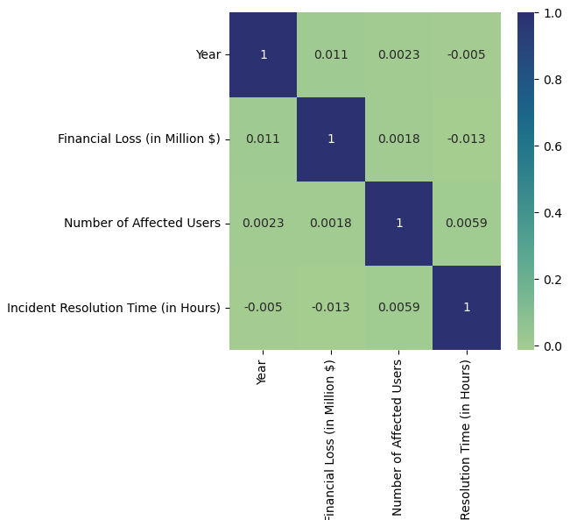

Bivariate - Numeric
We can see a small correlation between number of users impacted and incident resolution time, which makes sense.

Slide 12
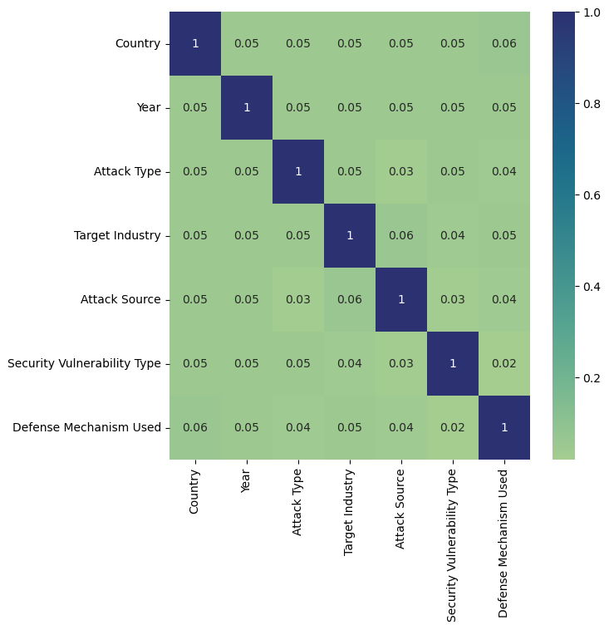


All Categoric
The strongest connections we can see are Target and Attack Type, then
Country and Defense Type

Slide 13
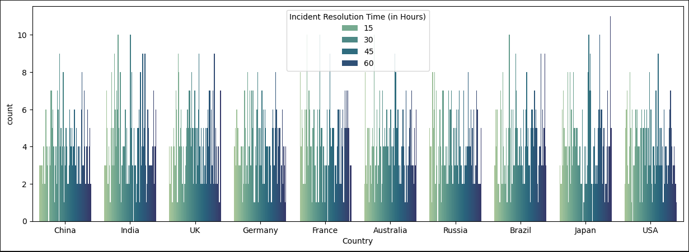
Resolution time by Country
Japan seems to have attacks that last a bit longer compared to others.
Russia and China seem to have fewer lengthy incidents.

Slide 14
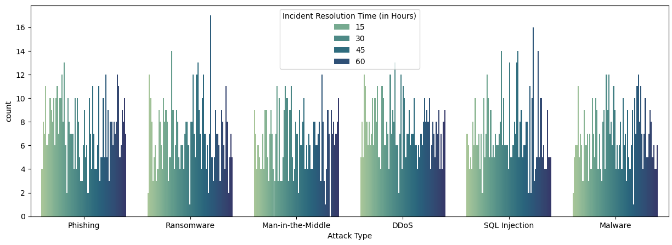
Resolution Time by Attack Type
Ransomware and SQL Injection style attacks seem to be the most time consuming to resolve.

Slide 15
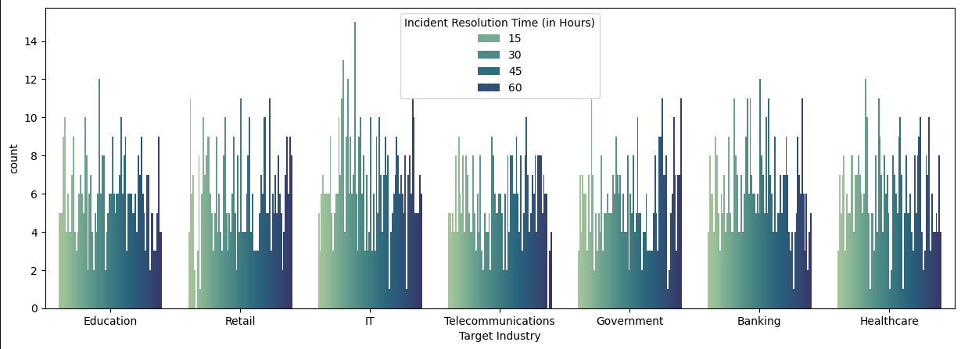
Resolution Time by Target Industry
Government and IT seem to have faster recovery times than some other industries, while also having some of the longer recovery times.

Slide 16
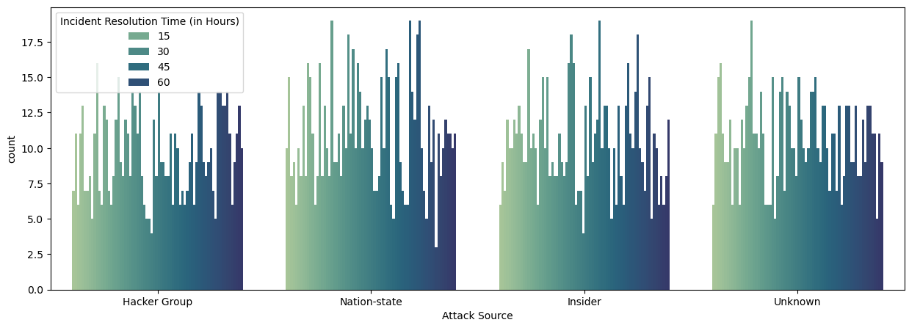
Resolution Time by Attack Source
Hacker Group and Nation State attacks appear to have comparatively longer resolution times.

Slide 17
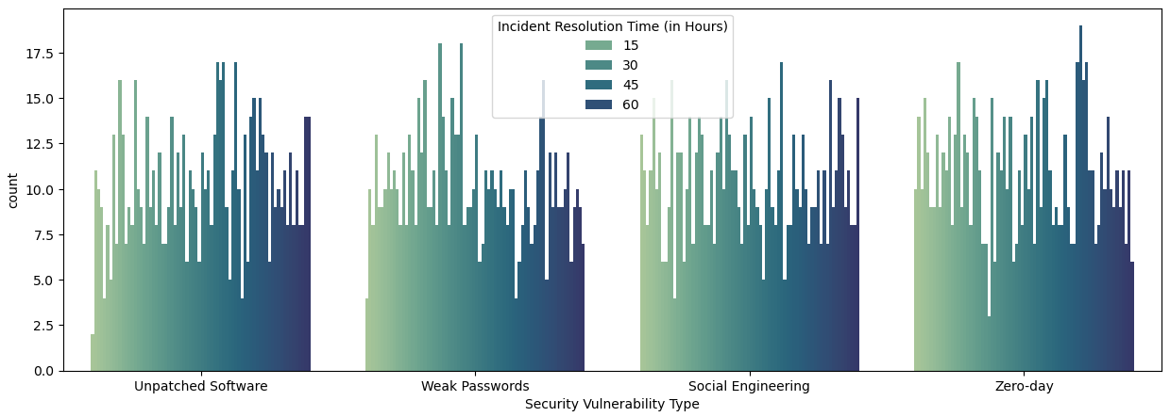
Resolution Time by Vulnerability Type
Zero days take longer to resolve than something like weak passwords.

Slide 18
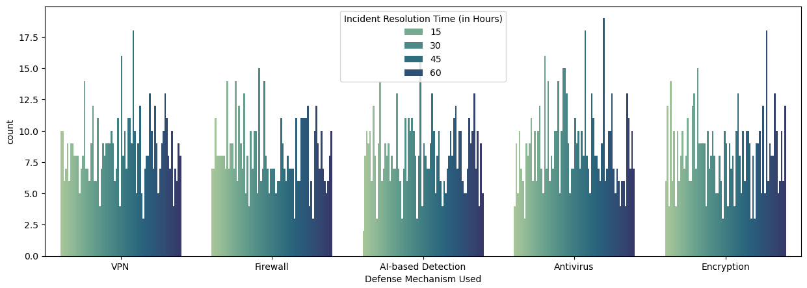
Resolution Time by Defense Type
AI-Detection and Encryption seem the most promising defense types here.

Slide 19
Target Variable and Why
“Incident Resolution Time (In Hours)” is the target variable for a few reasons.
Financial Loss doesn’t make sense as a target when government entities, education and retail are all involved together. The numbers would vary too much.
Users affected doesn’t make sense for much the same reason. The website of a government agency being hit is going to impact less people, but may have more drastic consequences than a DDOS attack on Twitter.
None of the categorical variables stand out enough or make sense as a target.
Time to resolve a crisis as a measure works across industries, and the number of users impacted doesn’t matter so much. Resources the industry has may skew it, but none of the other options seemed right.

Slide 20
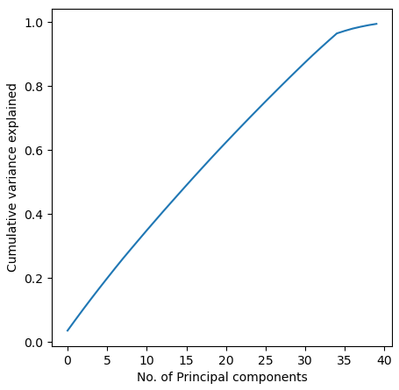
Principle Component Analysis
After converting all the categorical categories into binary variables there were 42 variables total.
PCA caps out at close to the same number.

Slide 21
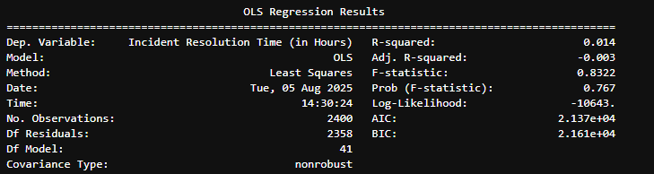
LR results
Terrible. Very Bad.
Also, if you try to improve them by dropping irrelevant columns it drops EVERYTHING but the constant. Making it more worthless.
Since maybe this wasn’t actually working with LINE requirements I tried a decision tree.

Slide 22
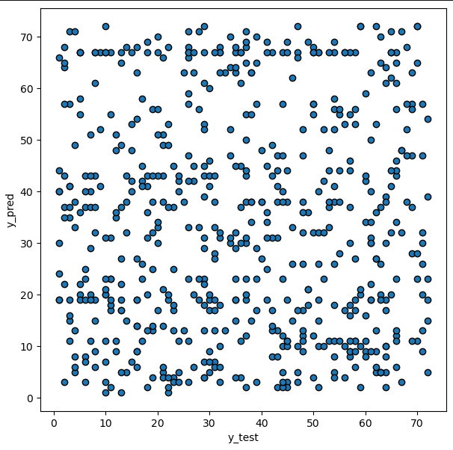
Why LR Likely didn’t work..
Well, Yeah there doesn’t appear to be a linear relation, fancy that.
LINE not met.

Slide 23
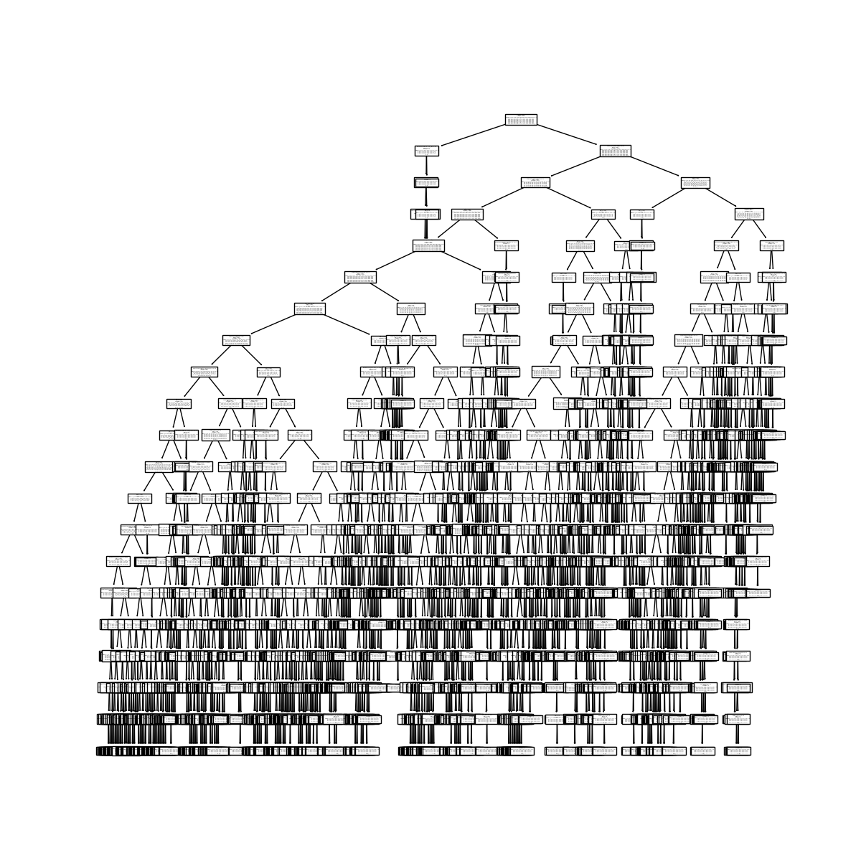
Tree results
This is obviously very overfitted.
It does alarmingly poorly on the test data.

Slide 24
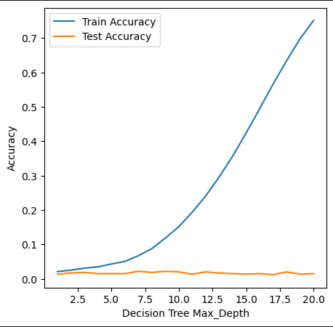
It’s bad
There is actually no way it seems to improve test accuracy. None.
So this data can’t really be modeled with Trees or with Linear Regression.

Slide 25

KNN Results
Failure here too.
Did not try a 4th model type.

Slide 26
Conclusion
This data while very interesting doesn’t really work for modeling.
Maybe if I sorted out just one industry in one country?
But then that would be a much smaller dataset.
Switching to a different variable likely would not have helped
I would have liked to see data for NATO and for the EU in governments.
More information on which companies were involved would also have been useful.
For ‘Nation State’ I’d have liked to see the responsible one (Russia is often blamed.)
Really the best solution is Knowledge and Prevention.

Slide 27
Hope you All learned a little something

